Slide 1

Innovate & Build Hackathon 2025
Problem Statement
Team Name: [Your Team's Name Here]
Team Members: [List Team Members]

Slide 2
Problem Statement & Background
Clearly defining the challenge and its context.
The Core Problem
What specific issue are we solving?
Its significance in the Indian context, supported by data.
Target Audience
Who is most affected by this problem?
Understanding their needs and pain points.

Slide 3

Proposed Solution
A high-level overview of our innovative approach.
Solution Overview
How It Works
What our project does, directly addressing the problem.
Mechanisms and core functionality at a glance.
Project Theme
Aligning with Healthcare & Life Sciences, Sustainable Tech, etc.

Slide 4

Key Features & Innovation
Highlighting the distinctive aspects of our solution.
Core Feature 1
Description of a primary functionality.
Core Feature 2
Explanation of another key capability.
Innovation Edge
What makes our approach unique or superior?
Core Feature 3
Adding value through a third essential feature.

Slide 5
Technical Architecture
The technological foundation of our project.
Tech Stack
Programming Languages: Python, JavaScript, etc.
Frameworks: React, Django, Node.js
Databases: MongoDB, PostgreSQL
APIs & Services: [List specific APIs/tools]
Specialized Tech: ML, Blockchain, IoT

Slide 6




Hackathon Prototype Scope (MVP)
What we will build and demonstrate in 9 hours.
Defined Features
User Experience
Exact functionalities built for the prototype.
What users can accomplish with the MVP.
Demonstration Goals
Key aspects to showcase during the hackathon.

Slide 7
User Interface (UI/UX) Mockups
Visualizing the user journey and final product experience.
These mockups illustrate the core screens and user flow of the application.

Slide 8
Impact & Scalability
Envisioning the future positive change and growth.
Community Impact
Positive changes for target users and society.
Addressing a significant need.
Future Growth
How the project can expand and evolve.
New features, markets, or integrations.

Slide 9




The Team
Team Member 1
Team Member 2
Team Member 3
Team Member 4
Role: Backend Developer
Role: UI/UX Designer
Role: ML Engineer
Role: Blockchain Expert
Skills: Python, API Integration, Database Management
Skills: Figma, User Research, Prototyping
Skills: Data Science, AI Models, TensorFlow
Skills: Solidity, Smart Contracts, Web3.js

Slide 10



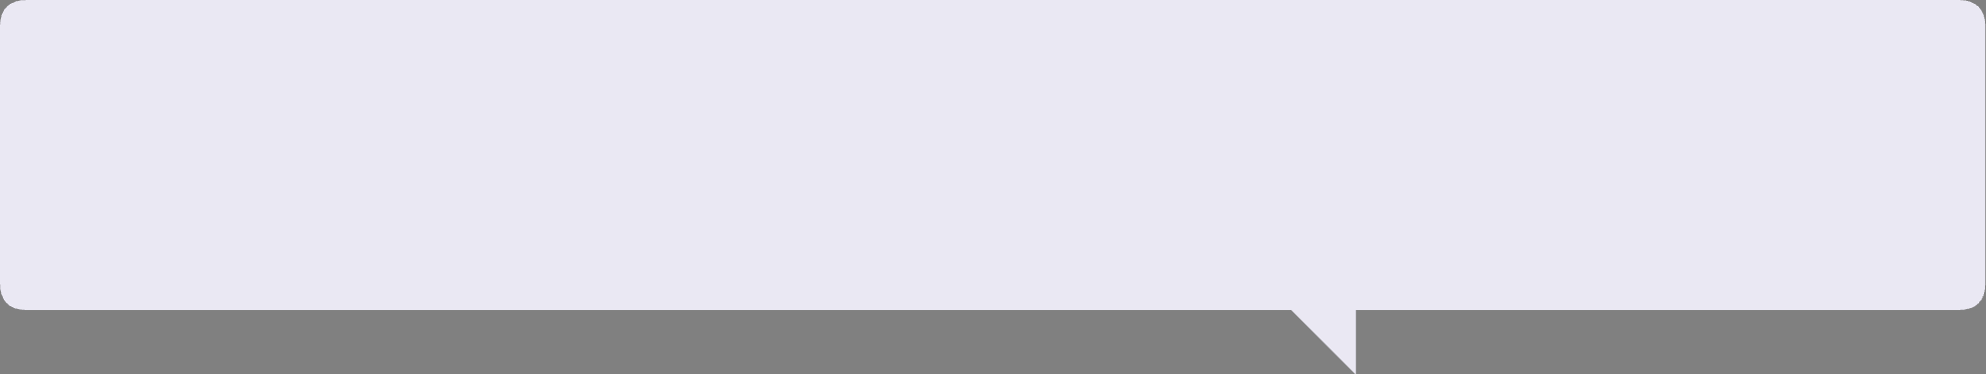
Thank You!
Innovate. Build. Impact.
Problem Solved
Innovative Solution
A clear, pressing issue addressed.
Our unique and effective approach.
Real Impact
Driving positive change for the community.

